Slide 1

Aligner Toolbox
By:
Mennatullah Mahmoud 18101713
Menna Abdelsattar 18101590
Moaz Rizkallah 18102436

Slide 2
Aligner Toolbox
Our toolbox is named “Aligner” and it is a command-based system which perform multiple functions.
It can be used to perform:
pairwise alignment between any two files
multiple sequence alignment between any numbers of files (Muscle and Kalign)
extract the conserved regions in any file (clw, html, MSF, clu)
make a phylogenetic tree ( in a newick format and a visualized tree)
count any kmer in any file
perform a graphical view of the difference between counts of certain kmers in any files (in 2 different ways)

Slide 3
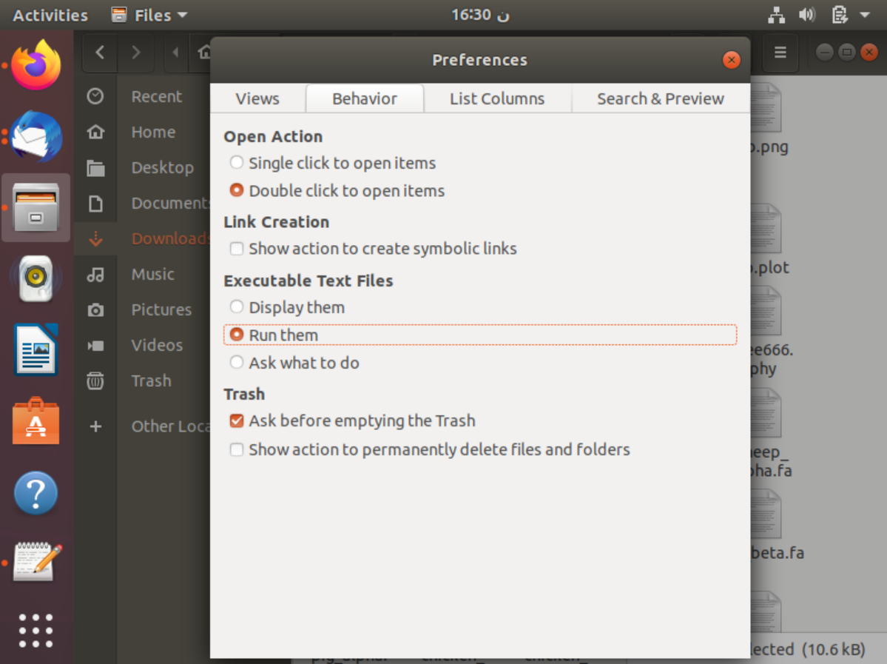
Our toolbox is a bash script which is named aligner.sh
All what we need to open our toolbox is to run the bash script by
$ bash Aligner.sh
Or we can simply change the preferences settings to run the file directly without any use of the terminal.

Slide 4
The data
We tried Aligner by using the alpha and beta globin of 17 different organisms (human, gorilla, mouse, cat, dog, chicken, pig, horse, frog, goat, sheep, bovine, macaca, rabbit, rat, zibrafish and chimpanzee)
Here we have 34 FASTA files of type protein
We downloaded these files from uniprot website

Slide 5
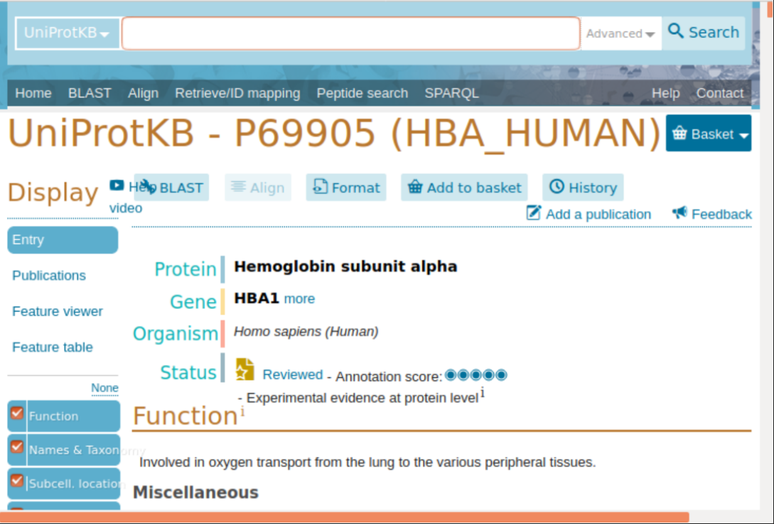
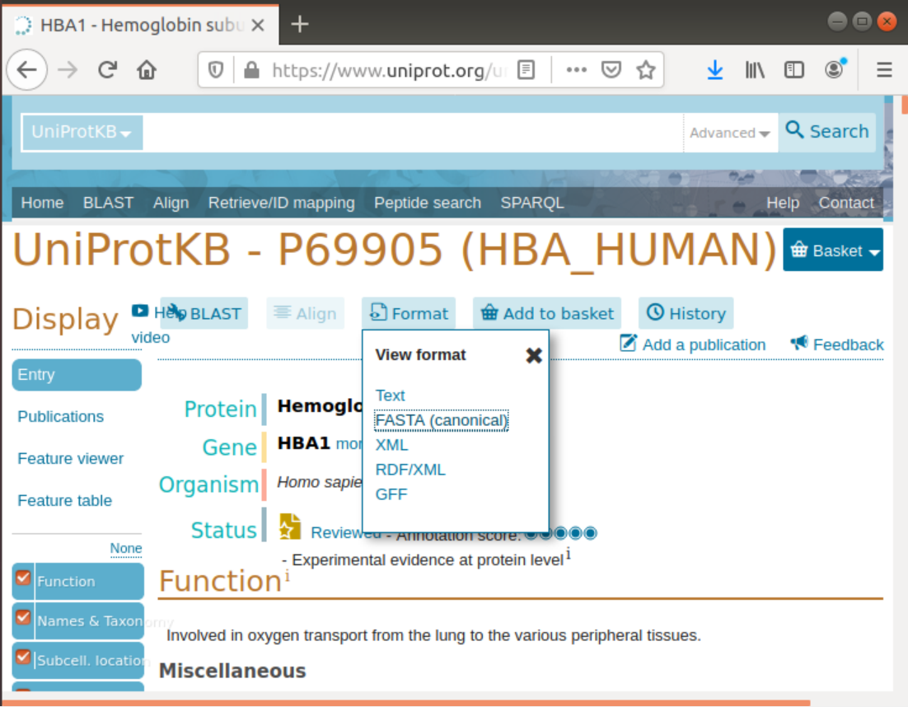
Uniprot
Then we downloaded this fasta format file.
This is human alpha globin gene

Slide 6
We downloaded all the 34 files by the same way.
The HBB gene provides instructions for making a protein called beta-globin. Beta-globin is a component (subunit) of a larger protein called hemoglobin, which is located inside red blood cells. These cells then travel through the bloodstream and deliver oxygen to tissues throughout the body.
The HBA gene provides instructions for making a protein called alpha-globin. Alpha-globin is a component (subunit) of a larger protein called hemoglobin, which is the protein in red blood cells that carries oxygen to cells and tissues throughout the body.

Slide 7
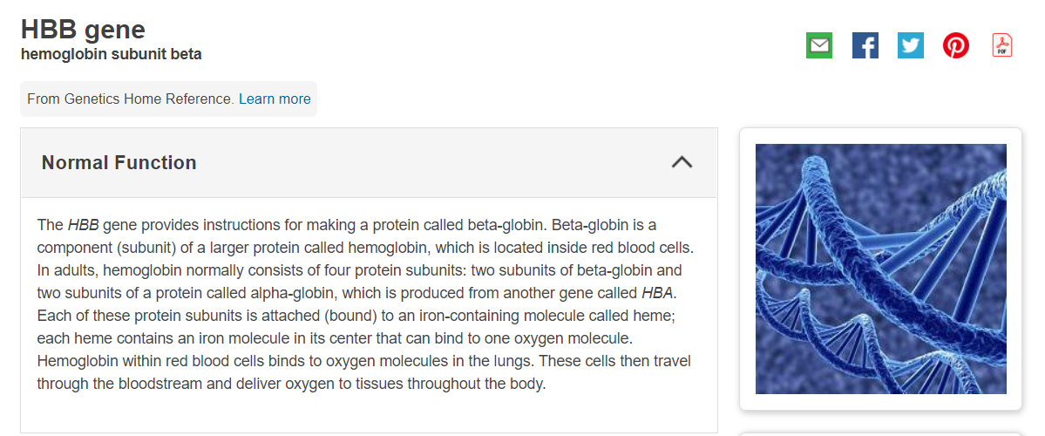
Functions of these genes

Slide 8
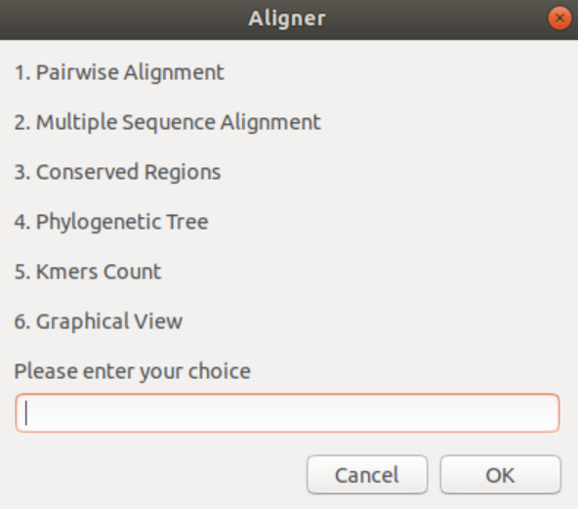
The Main Menu
Once the user run the bash script or directly opens the file, the main menu appears as shown in the figure
Aligner is a command-based system but presented by GUI so the user can use it without opening the terminal.
We used zenity library for the GUI
The user here has to write any number from 1 to 6 in the box below according to the function he wants to perform.

Slide 9
1-Pairwise Alignment
Pairwise Sequence Alignment is used to identify regions of similarity that may indicate functional, structural and/or evolutionary relationships between two biological sequences (protein or nucleic acid).
pairwise alignment process is done by making blast between the two organisms. BLAST (basic local alignment search tool) finds regions of similarity between biological sequences. The program compares nucleotide or protein sequences to sequence databases and calculates the statistical significance
We will make the pairwise alignment between human alpha globin and gorilla alpha globin file.

Slide 10
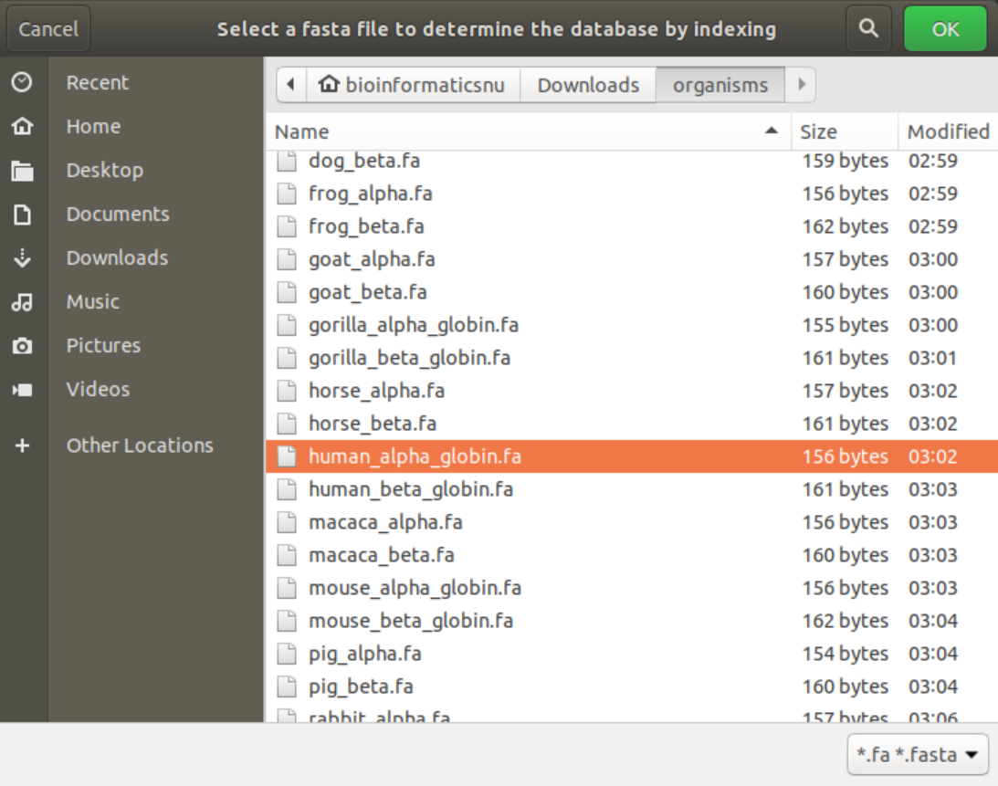
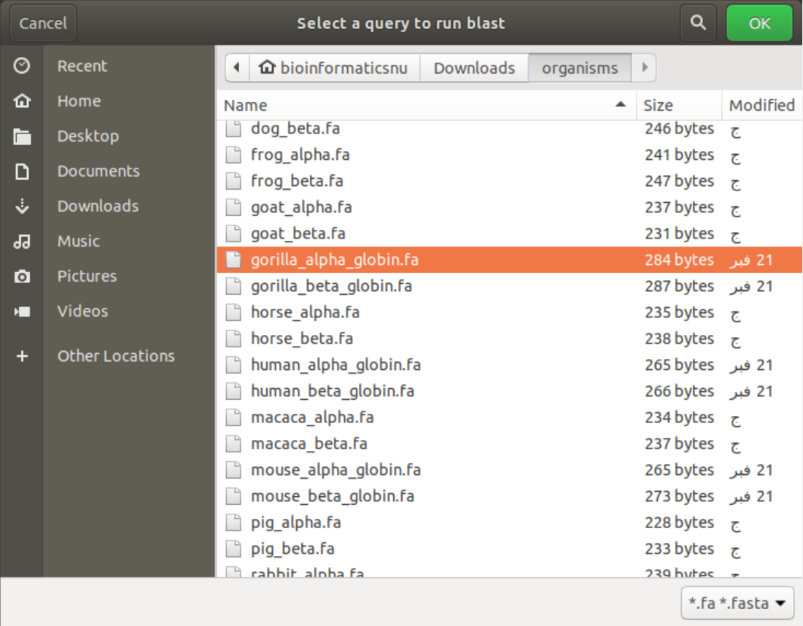
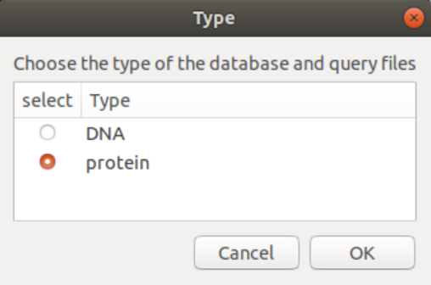
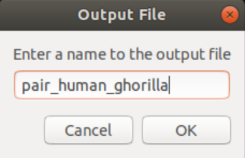
1
2
3
4

Slide 11
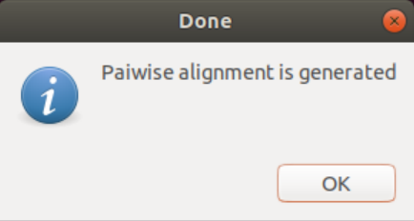
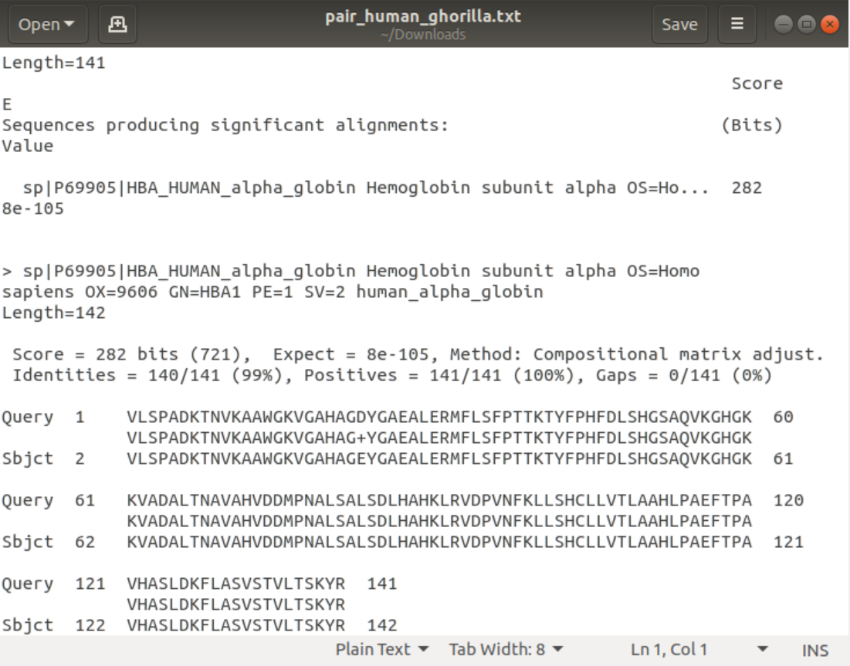
Aligner produces a message that pairwise alignment is generated
The human alpha file which is the database produced 3 files as a result of indexing
Besides, the main result of the pairwise alignment is stored in pair_human_gorilla.txt as entered in the previous figure
Here, the score of identities is 99% that is a large matching between amino acids of this gene in human and gorilla
This means that the sequences are very similar and homologous in the two organisms, they have arisen from common ancestor and more related to each other

Slide 12
2-Multiple Sequence Alignment
Multiple Sequence Alignment (MSA) is generally the alignment of three or more biological sequences (protein or nucleic acid) of similar length. From the output, homology can be inferred and the evolutionary relationships between the sequences studied.
We will make the multiple sequence alignment between all the 34 files of alpha and beta globin of each organism

Slide 13
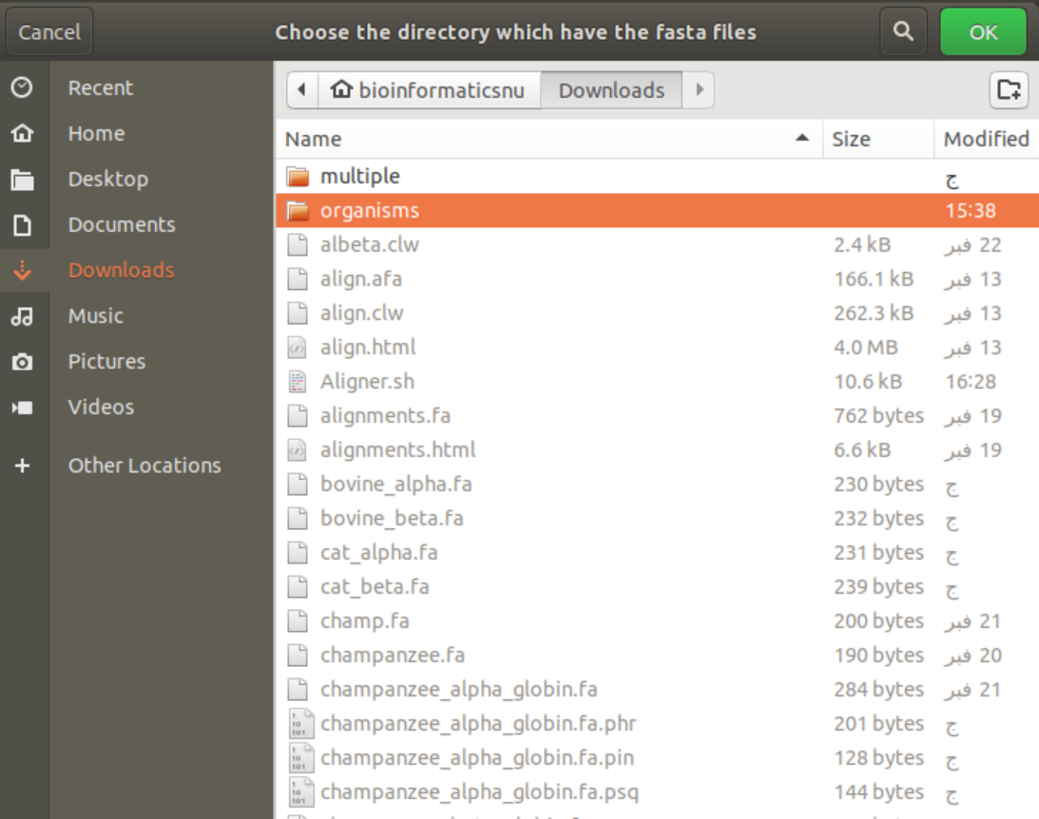
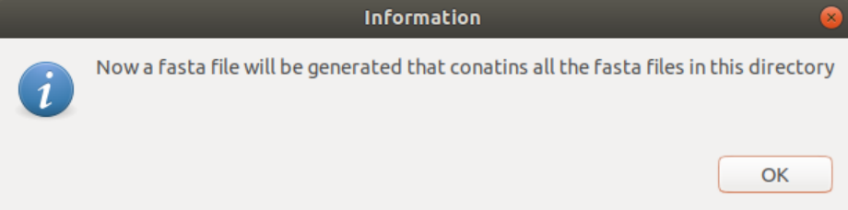
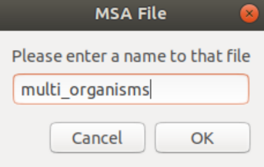
2
1
3

Slide 14
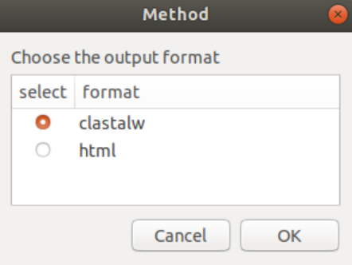
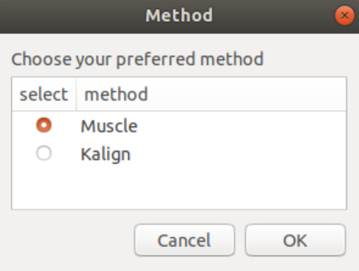
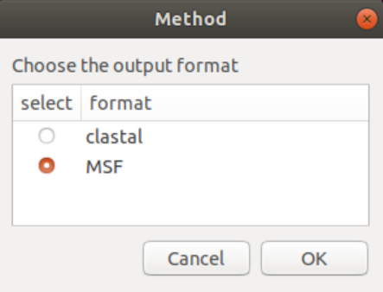
Muscle
5
4
Kalign

Slide 15
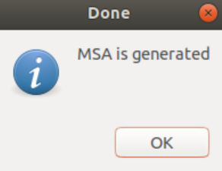
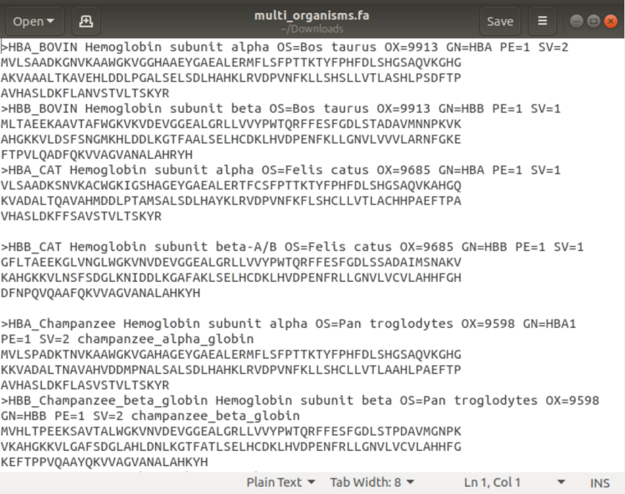
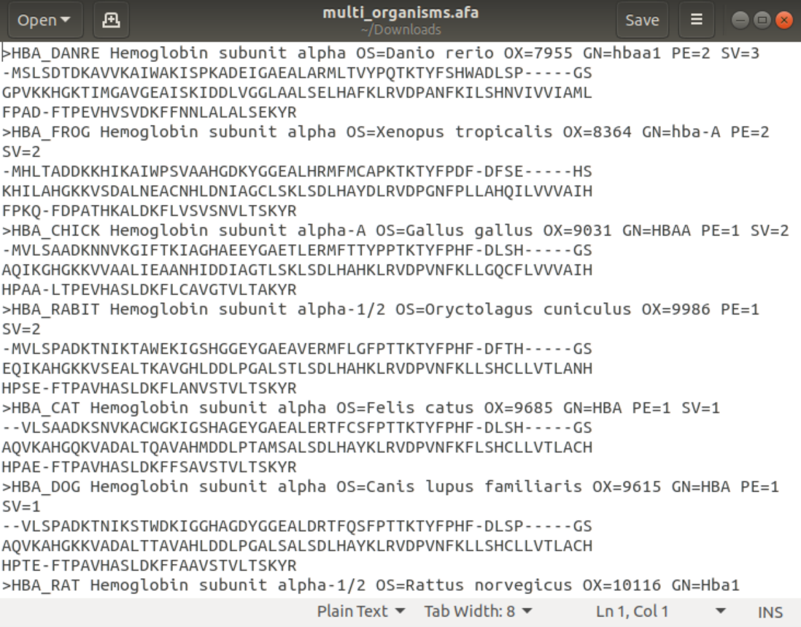
A message is generated that MSA is generated
A file containing all 34 fasta files concatenated in it which is called multi_organisms.fa
Besides, the main output which is the afa file

Slide 16
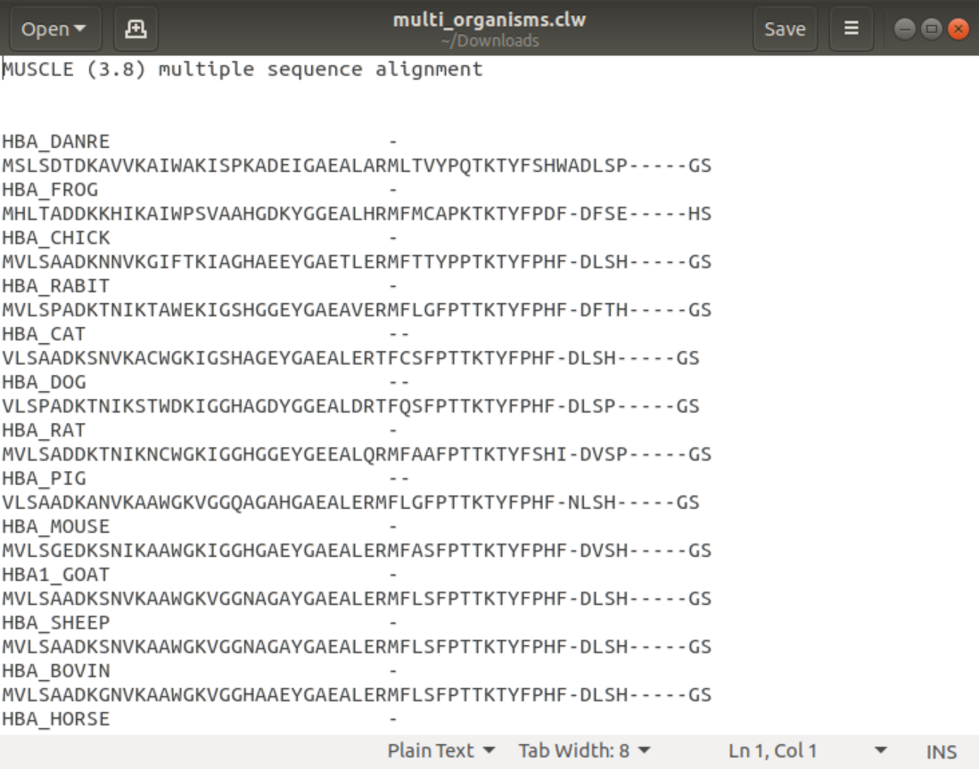
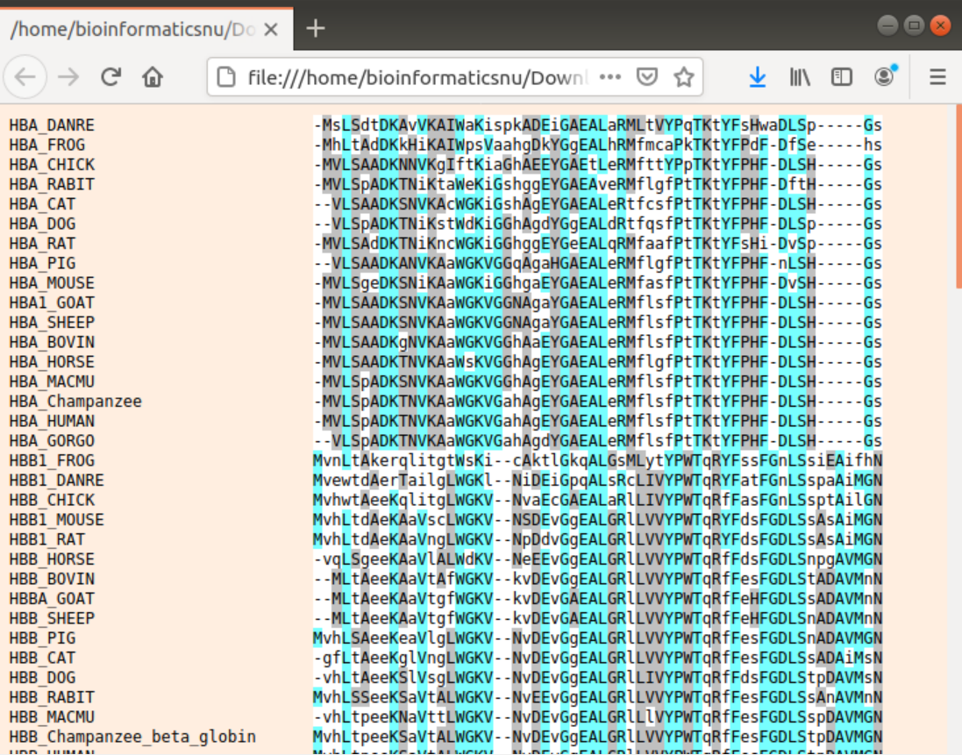
Formats of muscle
CLW
HTML

Slide 17
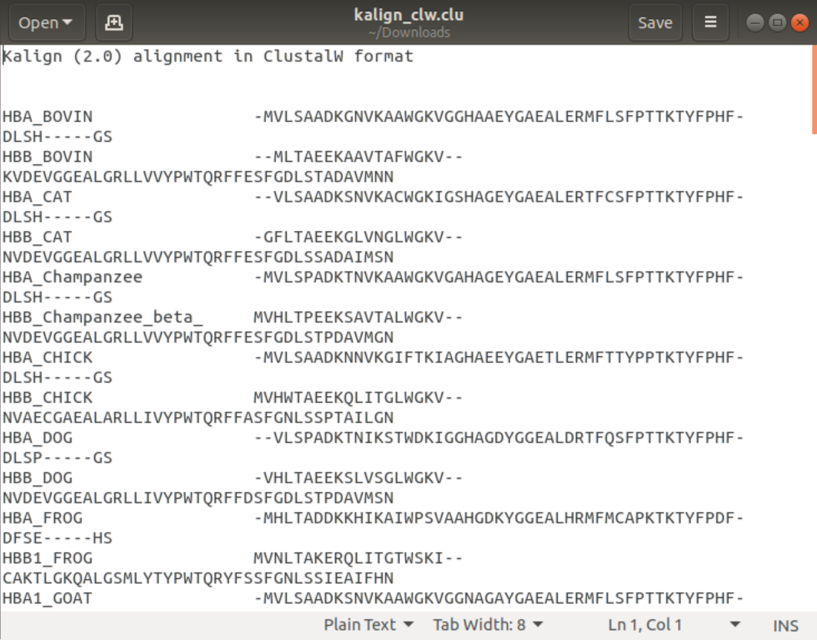
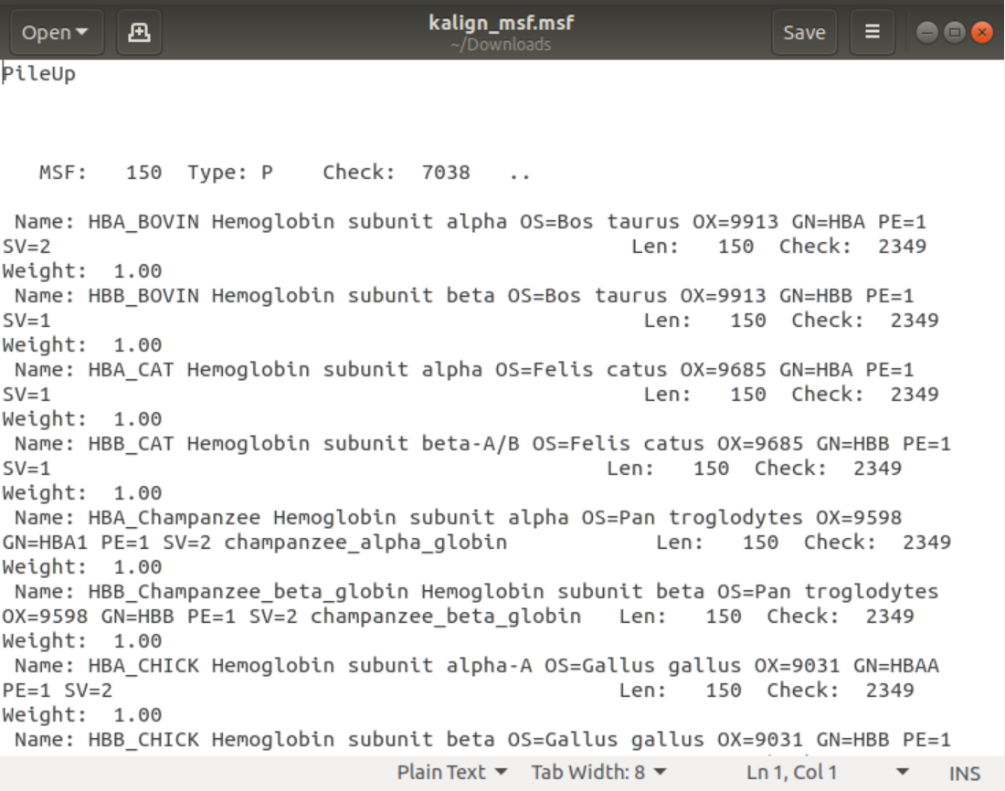
Formats of kalign
CLU
MSF

Slide 18
3-Conserved regions
conserved sequences refer to identical or similar sequences of DNA or RNA or amino acids (proteins) that occur in different or same species over generations. These sequences show very minimal changes in their composition or sometimes no changes at all over generations. So, a conserved sequence is a base sequence in a DNA molecule (or an amino acid sequence in a protein) that has remained essentially unchanged, and so has been conserved, throughout evolution.
Conserved sequences can be categorized into two major categories, orthologous and paralogous.
All organisms are orthologue as they are different species but have common genes and similar conserved regions.

Slide 19
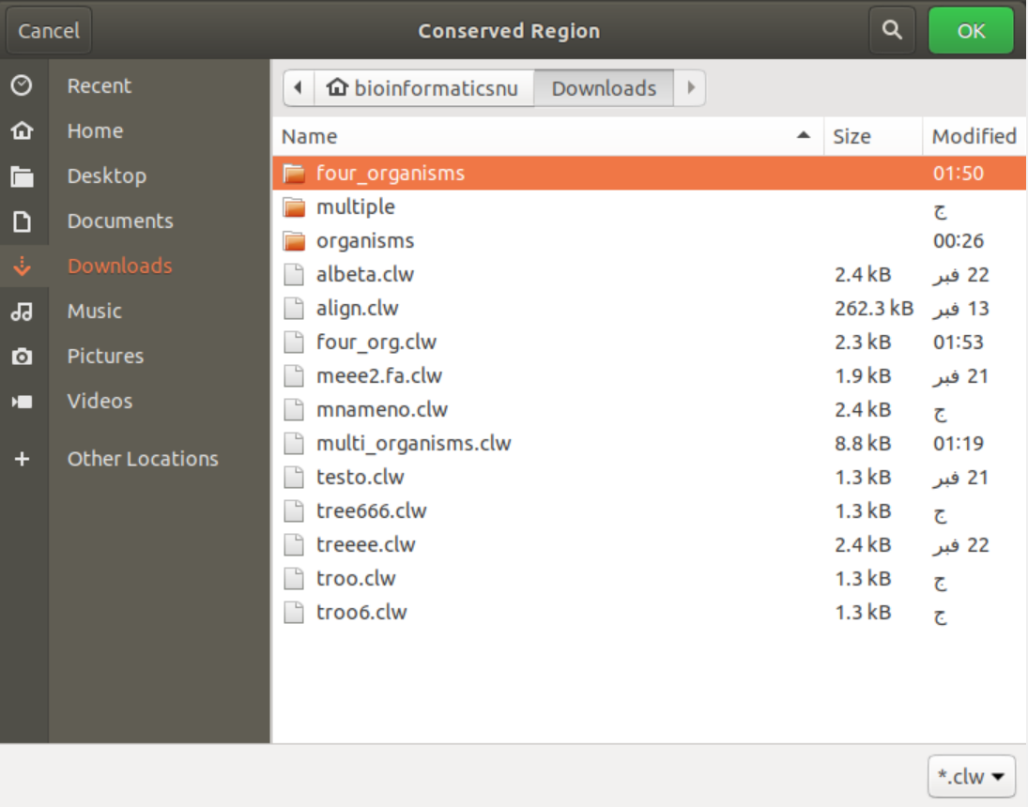
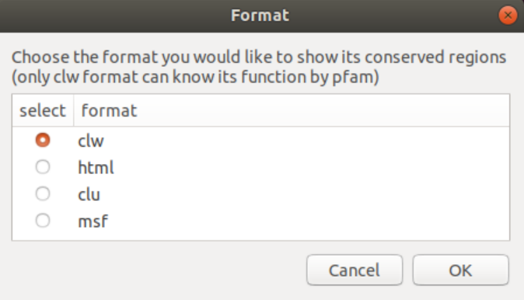
1
2

Slide 20
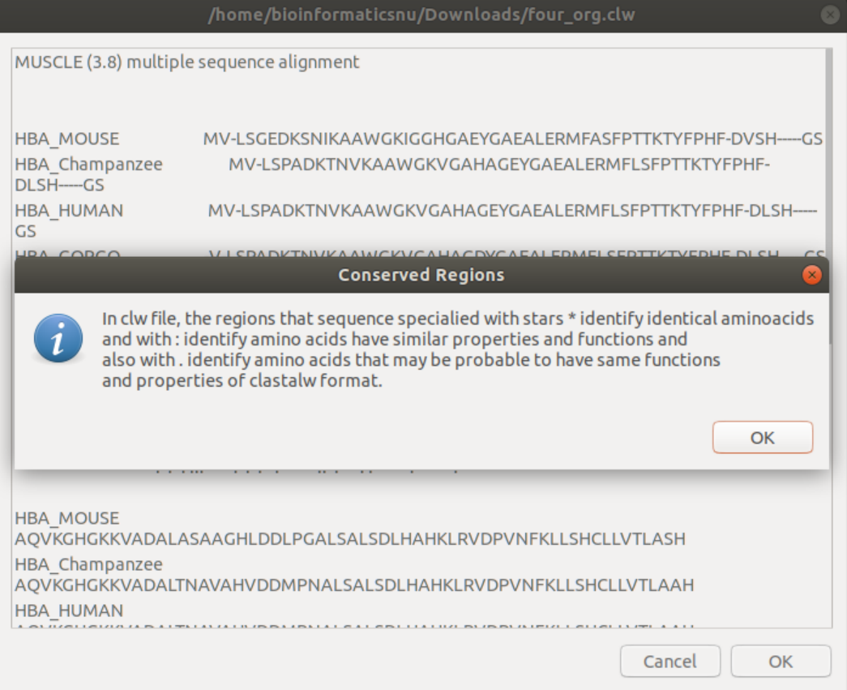
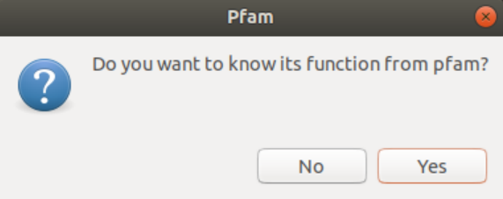

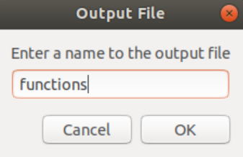
CLW
4
5
3
6

Slide 21
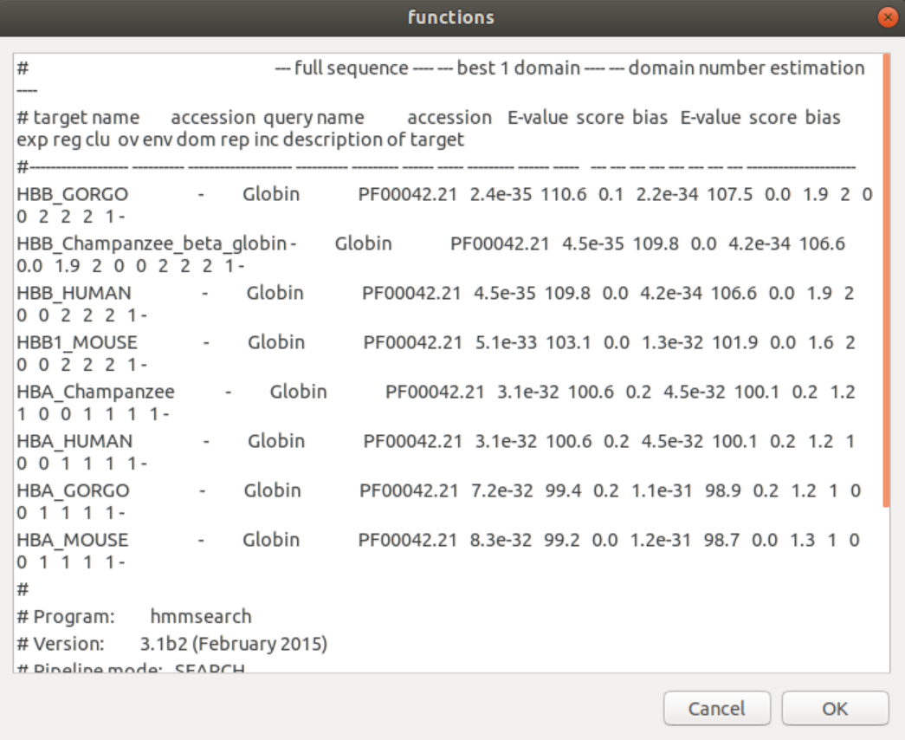
pfam
The Pfam database is a large collection of protein families, each represented by multiple sequence alignments.
And here is the output file:
7

Slide 22
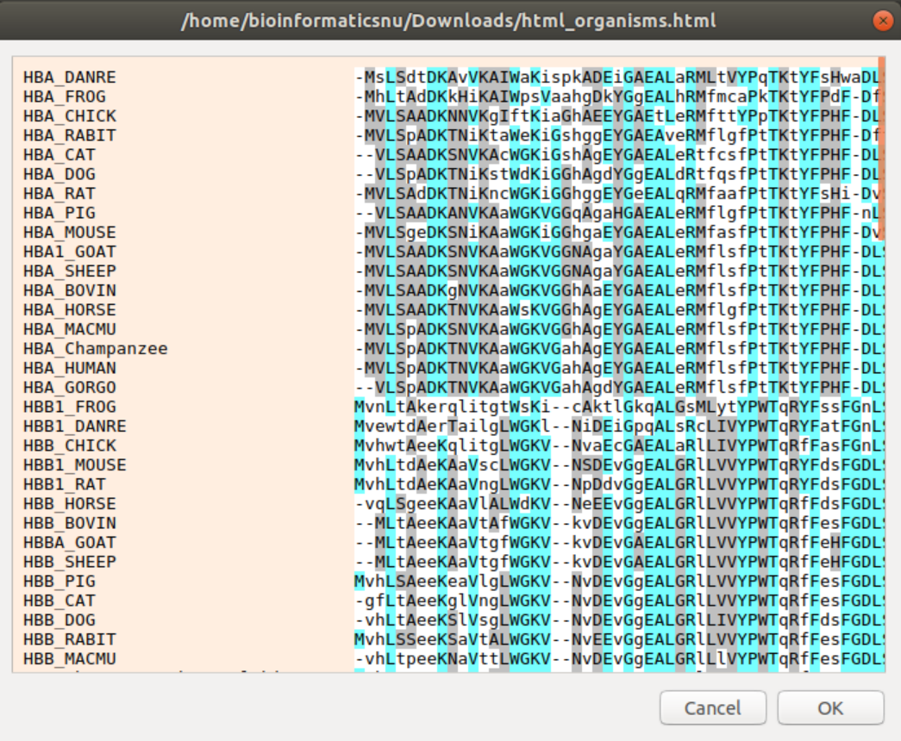
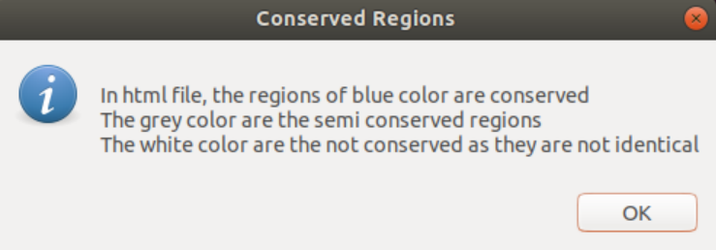
HTML

Slide 23
4-Phylogenetic tree
phylogenetic tree is a diagram that represents evolutionary relationships among different species, organisms, or genes from a common ancestor. It is useful for organizing knowledge of biological diversity, for structuring classifications, and for providing insight into events that occurred during evolution.
phylogenetic trees are also represented in [1]Newick format in the form of brackets not only graphs where the more related species are placed in the same bracket [2] and in visualized form.

Slide 24
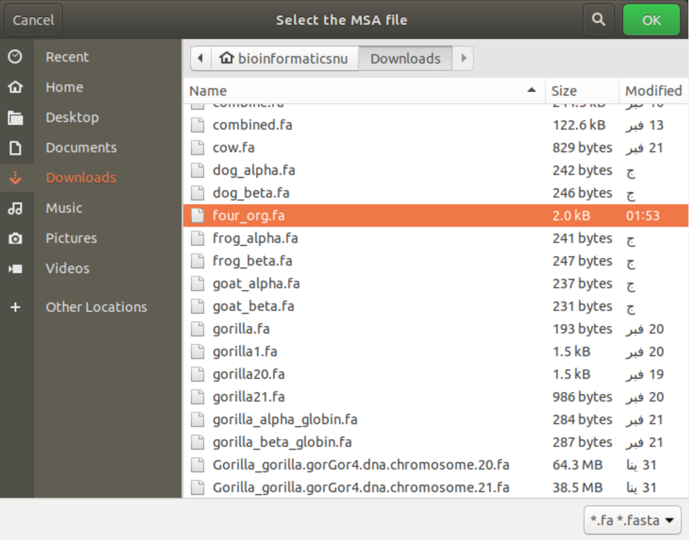
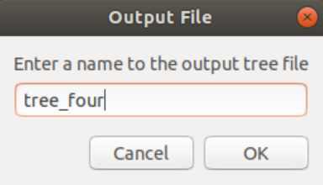
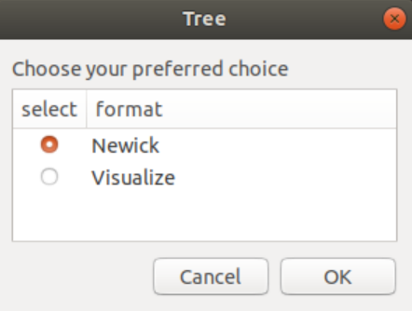
2
1
3

Slide 25
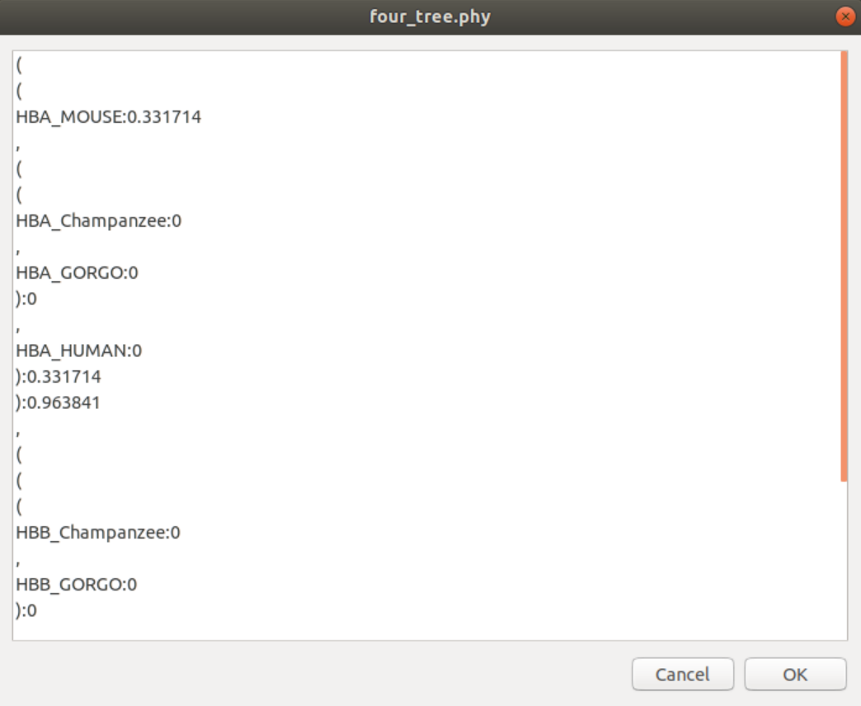
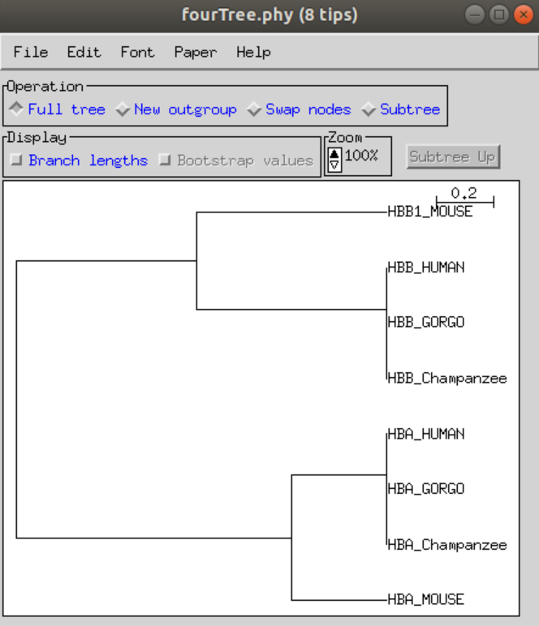
4

Slide 26
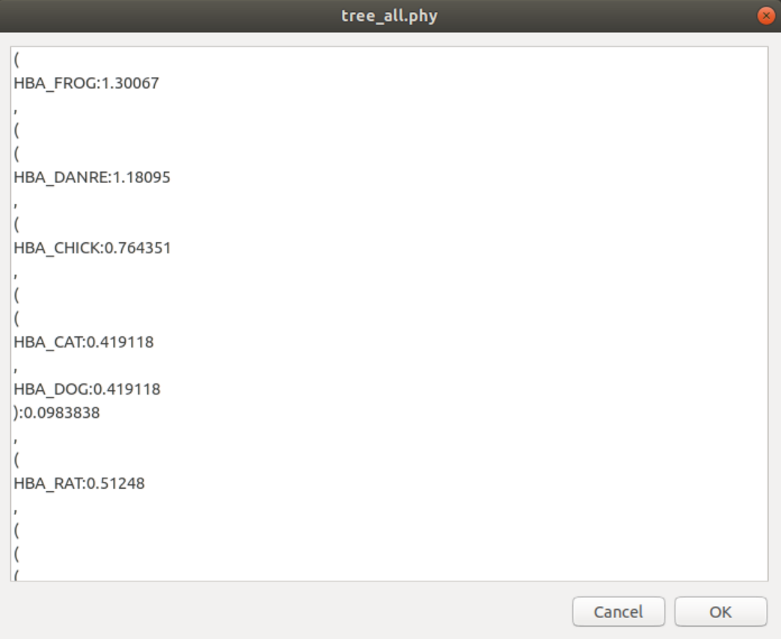
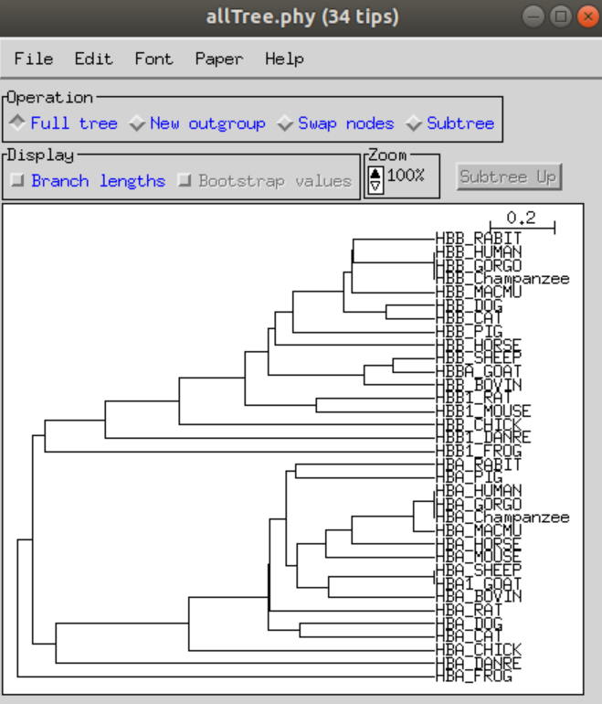

Slide 27
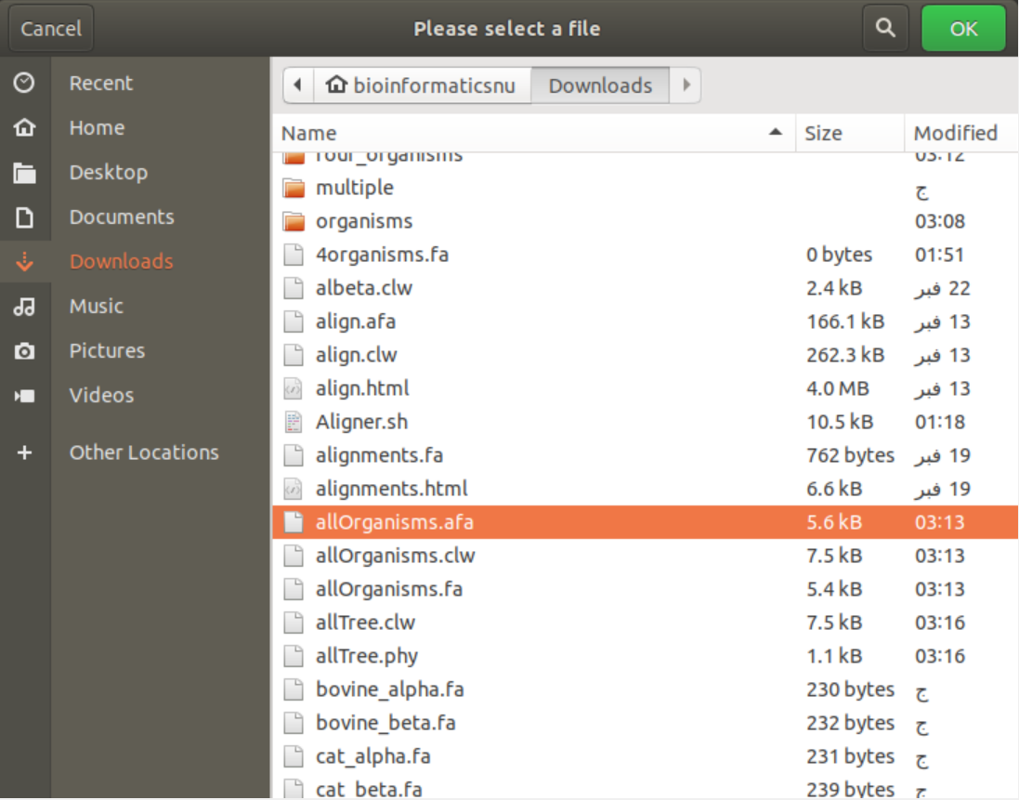
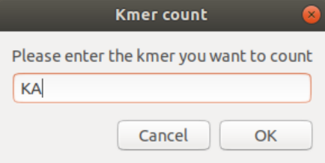
5-K-mers count
Aligner can count any kmer in any file
It can count any kmer regardless its length.
We will count kmer KA from a fasta file.

Slide 28
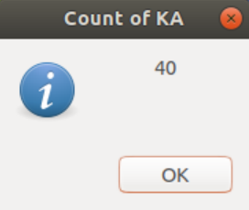
The result will be shown in an information box containing the count of Kmer KL in the file.

Slide 29
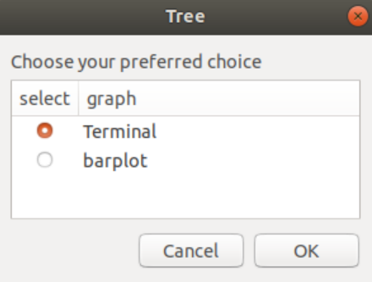
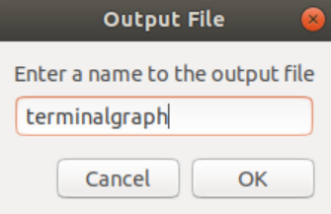
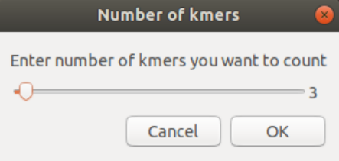
6-Visualization
Aligner has 2 types of graph
It can visualize the difference between any number of counts between any files

Slide 30
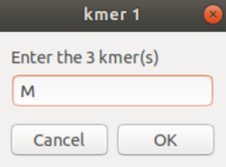
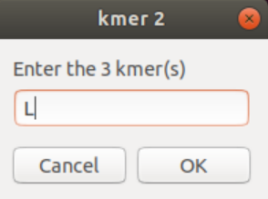
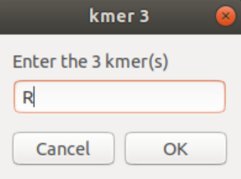
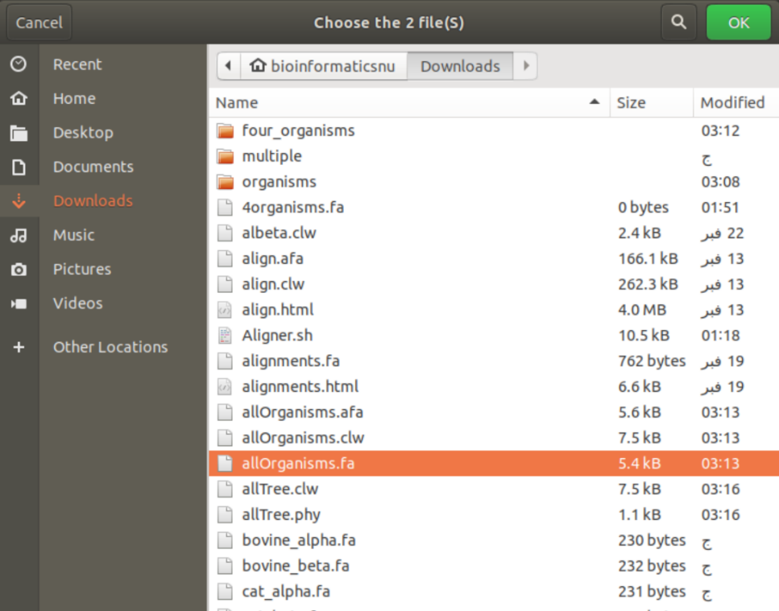
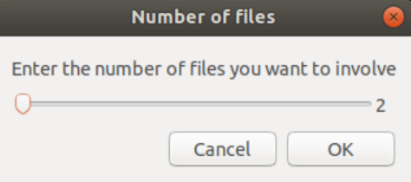

Slide 31


Barplot
Terminal

Slide 32

Finally, Aligner catches any error and exit the tool besides exiting it when any cancel button is pressed or the user answers no in any case. For example, in the first menu, if the user enters number 7 which is not in the list, the tool will show a warning that it is invalid choice
besides, inside the bash script all the tools used will be installed before by this command:
$ sudo -A apt-get install $tool
And the -A parameter to take the password of the device without entering it through terminal so the tool can be completely used without opening the terminal itself.

Slide 33

In the file selection in any function, Aligner only shows the file the tool wants. For example, in the pairwise alignment, this function can be done only on fasta files so the tool opens the file selection window with only files with extensions fa or fasta appears and the rest of the files will be disappeared.
finally, the notification in zenity helps the tool to notify zenity with any information in any step.

Slide 34
Contributions
Moaz Rizkallah:
Pairwise alignment using blast
Menna Abdelsattar:
Multiple sequence alignment
Conserved regions
phylogenetic tree
Mennatullah Mahmoud:
Counting kmers
Graph
Pfam in the tool
GUI
Tool analysis section

Slide 35
Thank you

